Slide 1
Product Management
Internship
Mid-Review
Project-:
IM Ads Automated Performance Attribution & Hierarchical Analytics Framework
Kratika Agarwal
Product Management Intern, April 2026 – Present
Google Ads · Analytics · Automation · KPI Tracking

Slide 2
Role & Business Understanding
Core Concepts
Objective
Buylead Lifecycle
Expires in 3 days · Max 5 sellers can respond
“Build intelligent automation & BI solutions
to drive decisions, maximise BL generation and BL sold revenue across
IndiaMART’s Marketplace Shopping Ads campaigns.”
Pause/Unpause
Ads Paused when BL Count on MCAT>40(Last 3 Days)
PMCAT Strategy
↑ Ads for 0 BL MCATs · ↓ Ads for ≥100 BL MCATs
Initial Week Insights
KPI Flag Thresholds
Flag
Transactions
Action
Shopping Ads over Search Ads — visual ads outperform text for B2B buyers
Google Ads auction system — competitive bidding dynamics with real-time pricing
Non-IM Sellers running their ads directly on IndiaMART platform for product visibility
🔴 High
400+
Scale & maintain
🟡 Medium
350–400
Optimise spend
🟢 Low
300–350
Boost ad exposure
Notes:
Mutual gains of busy user- and IM..

Slide 3
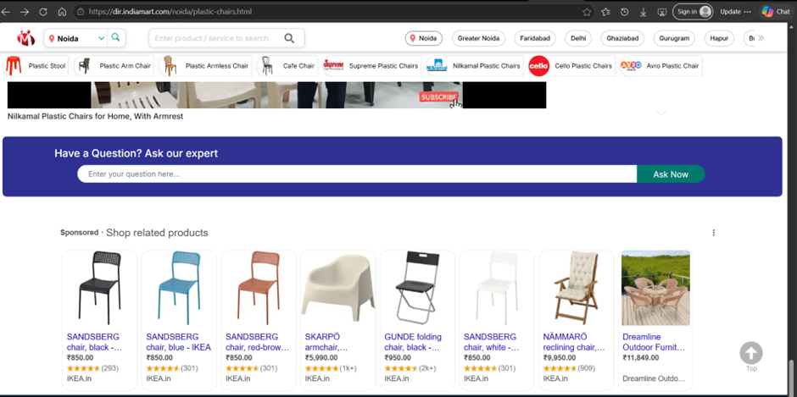
Role & Business Understanding
Notes:
Mutual gains of busy user- and IM..

Slide 4
Painpoints- Things I need to automate/what are actual painpoints that I had to automate.
Manual MCAT Lifecycle Actions: Tracking and updating pause/unpause statuses for active/inactive MCATs was manually managed, introducing delays and lifecycle instability.
Dashboard Fragmentation: No single source of truth for ads performance metrics; stakeholders had to manually request sheets or run isolated queries to compile KPI visuals.
Manual Weekly Calculations: Creating the Daily KPI Tracker for B&C campaigns required copy-pasting raw prior values and writing formulas manually every week.
Active Ads Data Bottlenecks: Checking active ads required manual Mesh lookups, resulting in massive data reconciliation gaps (~19K expected vs ~13K DB records).
Product Mismatch Identifications: Detecting custom label mismatches for Product Type 4 involved manual Ads console downloads and Excel cross-joins.
Sheets Latency & Rates: The legacy attribution dashboard was bottlenecked by slow Google Sheets integrations, rate-limiting updates, and lacked daily/monthly granularity.

Slide 5
Tasks Overview
# | Task | Focus Area | Status | EDD
1 | Pause/Unpause MCAT Analysis Automation | MCAT lifecycle & instability tracking | Completed | 29 Apr 2026
2 | Interactive KPI Dashboard | Real-time ads performance visualization | Completed | 6 May 2026
3 | Daily KPI Tracker — B&C Campaign | Automating weekly → daily KPI reporting | WIP | 30 Apr 2026
4 | Active MCAT Ads Data Automation | Fetch live MCATs with active ads | WIP | 3 May 2026
5 | Product Label Mismatch Detection | Custom label-3 inconsistency detection | On Hold | TBD
IndiaMART | Product Management Internship | April 2026
Notes:
Mutual gains of busy user- and IM..

Slide 6
Task 1: Pause/Unpause MCAT Automation
PROBLEM
No visibility into MCAT pause/unpause behaviour
Difficult to identify unstable or inefficient MCATs
APPROACH
01
02
03
04
Initial
Exploration
Data Structuring
& Merging
Automation
Attempt
Final Solution
(Delivered)
Raw pause/unpause data from live sheets
Pivot: paused vs unpaused MCAT counts
Instability Score = Pause + Unpause freq.
Identified top unstable MCATs
Unpaused sheet as base dataset
Merged Pause + Unpause on MCAT ID
"Currently Paused" flag for unmatched rows
Cycle tracking: Pause Date(Pause BL) → Unpause Date(Unpause BL)
Translated manual logic into LLM automation
Fetched & processed live sheet data
Data missing before 8 Apr · bad outputs
Longest Currently Paused MCATs
Heatmap-style pause/unpause timeline
Count of MCATs paused till today
Count of MCATs unpaused today
Daily 9 AM email: Top 10 + Google Sheet attach
›
›
›
MCAT Pause/Unpause Analysis Report | 29-04-2026 - kratika.agarwal@indiamart.com - IndiaMart InterMesh Ltd. Mail
Limitation
Limitation
Key Decision
No lifecycle visibility · Missing cycle-level insights
Manual/ Not Automated.
Visually Difficult to Understand
Reduced scope → last 10 days for clarity & scale
Notes:
Mutual gains of busy user- and IM..

Slide 7
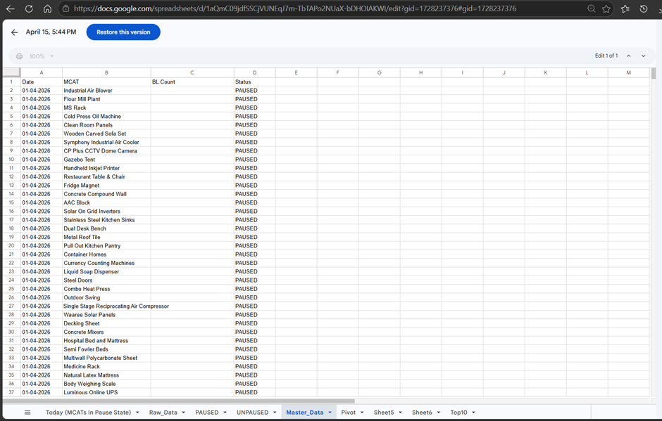
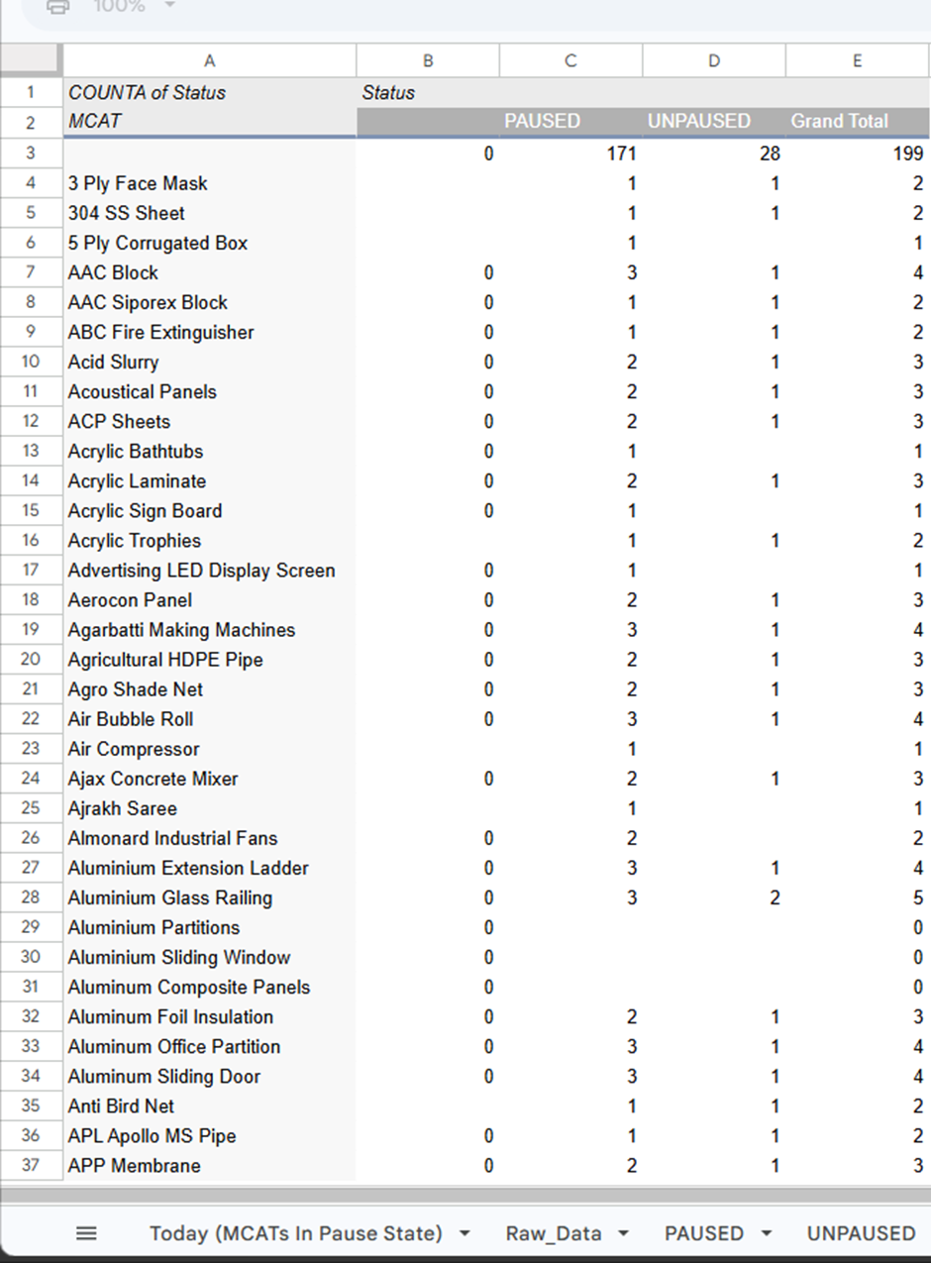
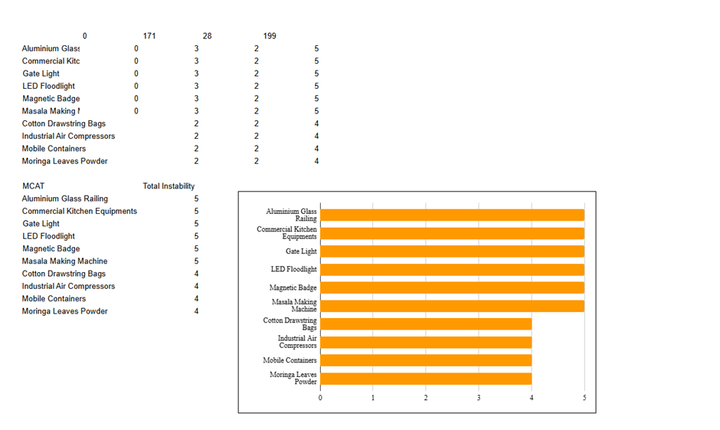
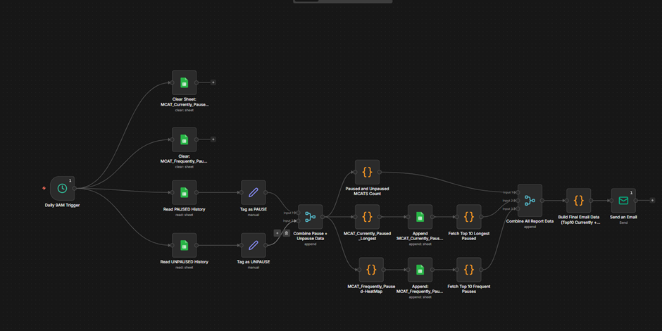
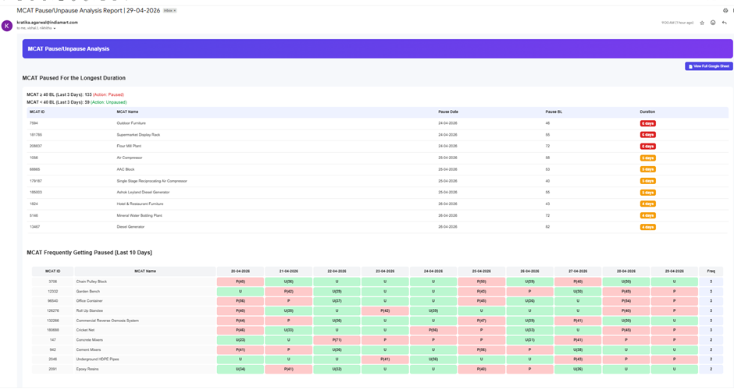
Task 1: Pause/Unpause MCAT Automation
Notes:
Mutual gains of busy user- and IM..

Slide 8



Task 2: Interactive KPI Dashboard/ All tasks in this one. Hygiene report to be fed here.
📊 KPI Dashboard (Prototype)
Dashboard Roadmap
₹18.4
82%
6
Phase 1 — Done
Cost/Txn
BL Approved
Overspend MCATs
Product Ads monthly data loaded
KPI metric tiles designed
Cost/Txn bar chart live
Phase 2 — Done
Paused/Unpaused BL Insights
Automated daily data refresh
Campaign Wise Daily, Weekly & Monthly Integration
Top Paused MCATs
Cotton Drawstring
8 days
Phase 3 — Done
Industrial Bolts
5 days
Live DB feed via Redshift (Prod/Dev pools)
LED Panels
4 days
Product Ads Dashboard — Monthly Report
9 / 11
Notes:
Mutual gains of busy user- and IM..

Slide 9


Task 3: Daily KPI Tracker — B&C Ads Campaign
BEFORE (Manual)
AFTER (Automated)
Weekly copy-paste of prior week's values
App Script auto-appends column on schedule
New column with formulas added manually each week
Values copied programmatically — no manual step
DBeaver access not provisioned → blocked
VS
DBeaver credentials obtained from Kishalay
Google Ads data restricted access to run scripts
Ads data fed from Vishal's live sheet (real-time)
In Progress: Daily Tracker - Google Sheets
PostgreSQL connection intermittently dropping — investigation to be done with Kishalay.
Extend to other campaigns
Diagnose the NaN values being sent over email
7 / 11
Notes:
Mutual gains of busy user- and IM..

Slide 10
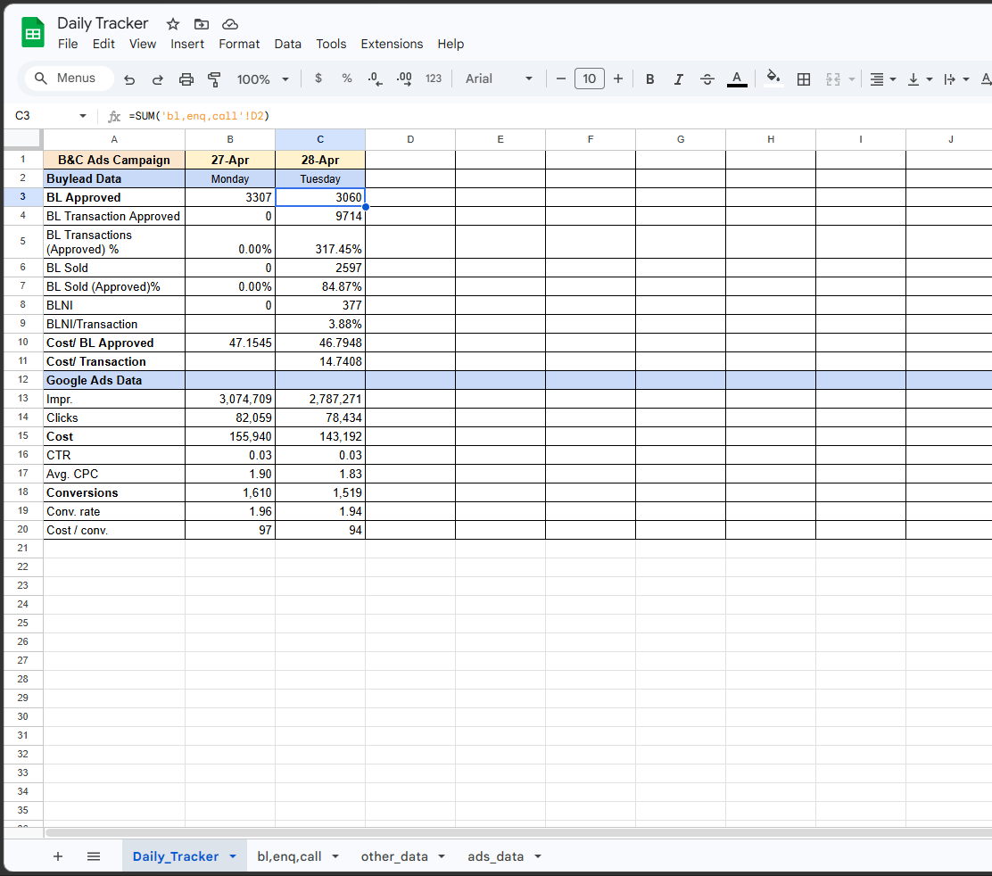
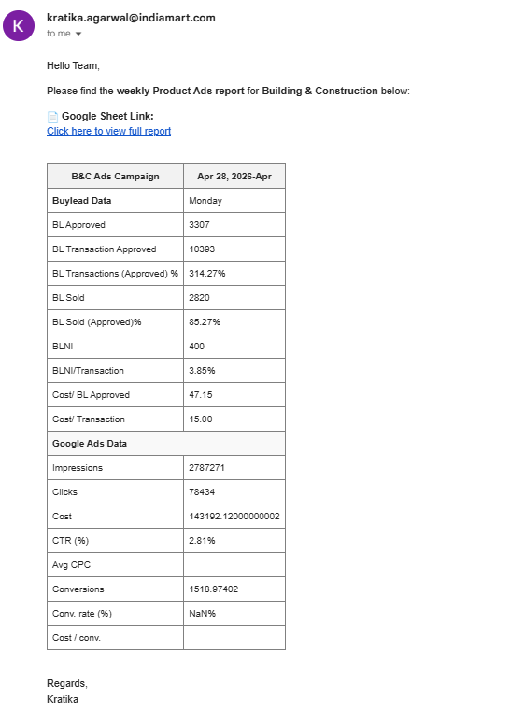
Task 3: Daily KPI Tracker — B&C Ads Campaign
Notes:
Mutual gains of busy user- and IM..

Slide 11
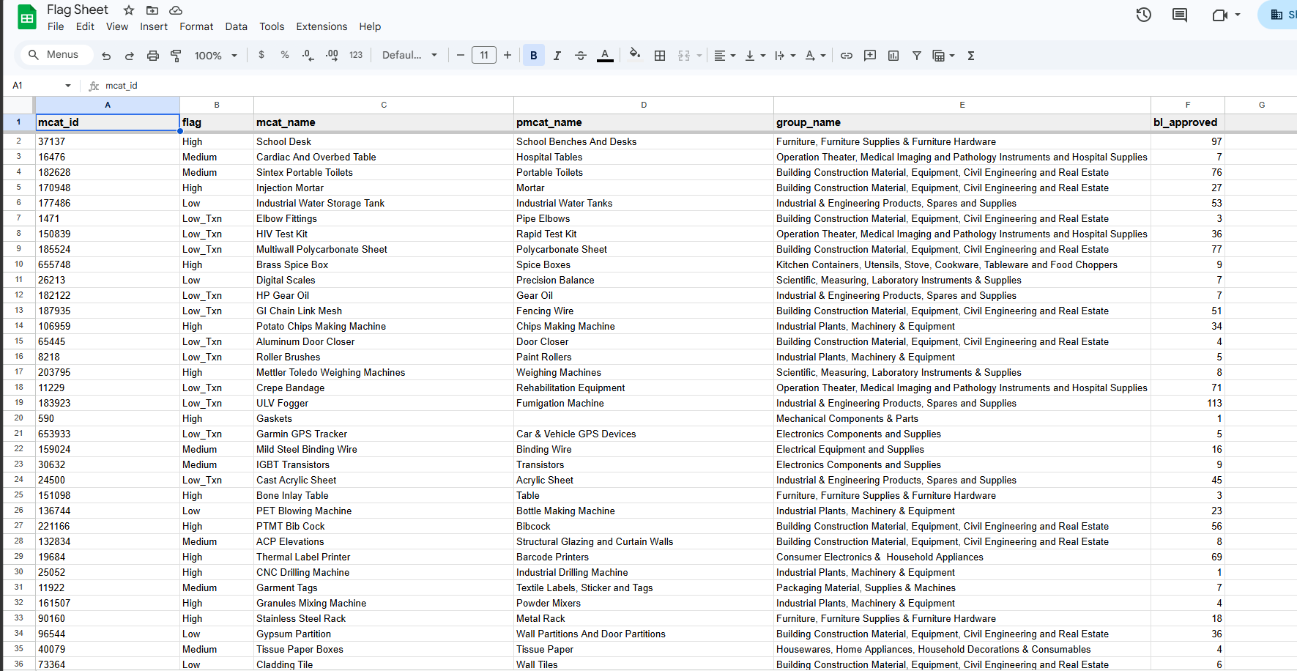

Task 4: Automating Active MCAT Data Fetch
Building a live SQL pipeline to replace manual Mesh lookups
Tables Joined
glcat_mcat_addn_attributes
iil_google_ads_lable_master
dim_glcat_mcat (dim)
fact_iil_google_ads_eligibility
13,351
~19K
5
Records fetched
Expected (Mesh)
Fields retrieved
⚠ Gap: 13,351 vs ~19K records
Investigating eligibility filter logic + BL_Approved join condition.
8 / 11
Notes:
Mutual gains of busy user- and IM..

Slide 12
Task 5: Product Label Mismatch Detection
Google Ads Report
✓ Status — Manual Phase Complete
1
Product-level Custom Label 3 data downloaded from Google Ads console.
Downloaded product report from Google Ads console
Matched MCAT IDs with weekly Custom Label 3 snapshot
MCAT Label Mapping
Identified all Product Type 4 label mismatches
2
Weekly MCAT-wise Custom Label 3 map (sourced from Nikhita) cross-joined.
Delivered actionable list to the ads team
Mismatch Detection
3
Products with label ≠ expected label for Product Type 4 identified.
⚡ Next: Full Automation
Live MCAT-wise Custom Label 3 feed needs to be automated — replacing the weekly manual download with a direct API or DB pull to enable continuous mismatch monitoring.
Actionable List
4
Full list of mismatched products exported — ready for correction.
6 / 11
Notes:
Mutual gains of busy user- and IM..

Slide 13
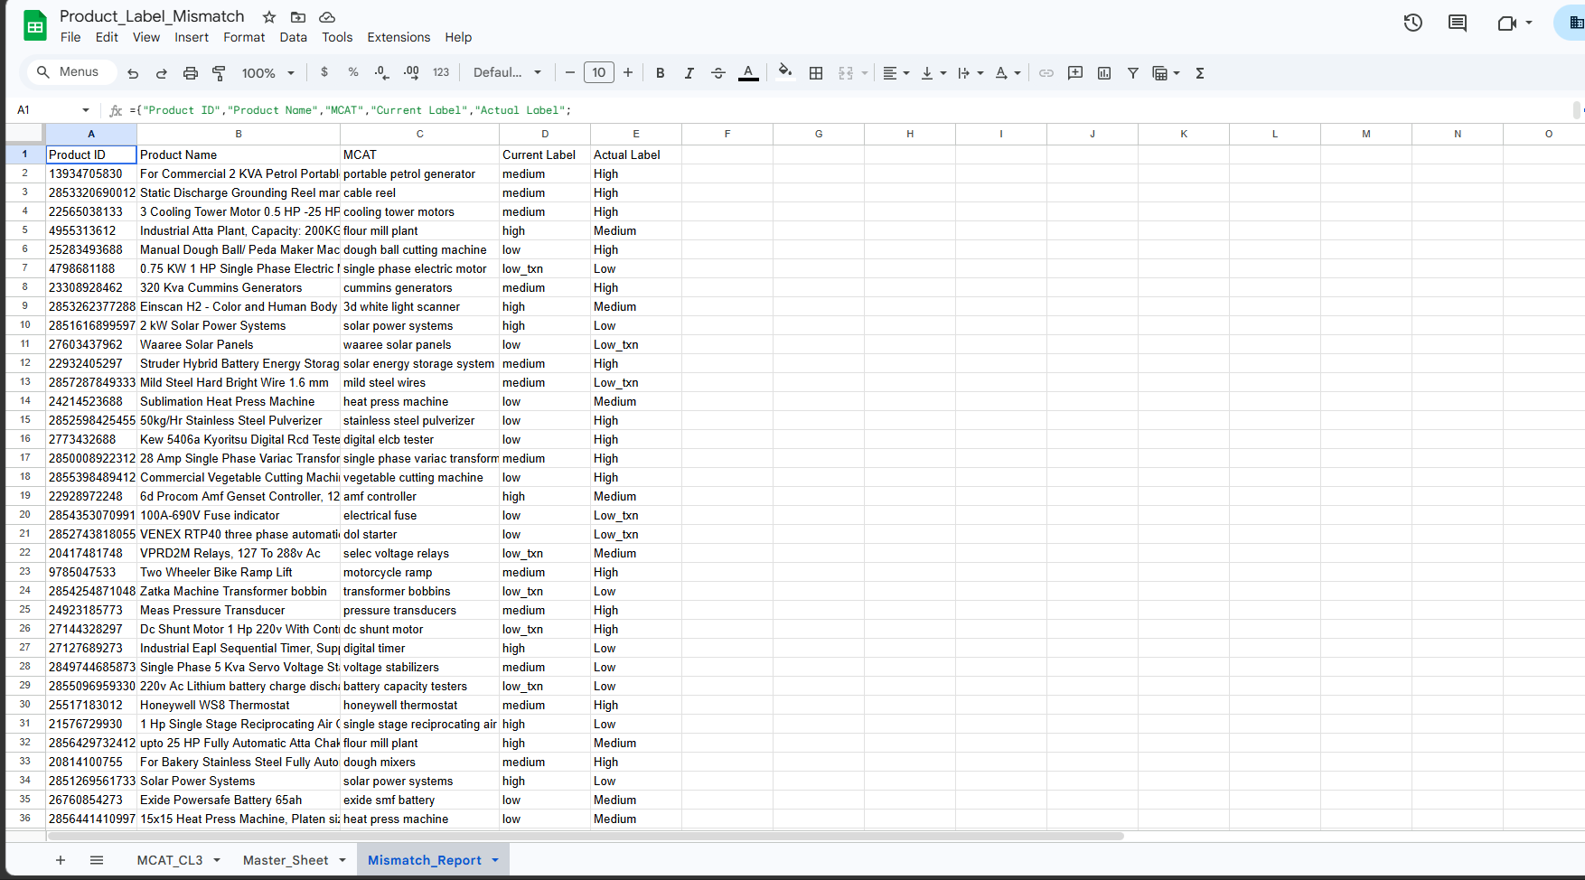
Task 5: Product Label Mismatch Detection
Notes:
Mutual gains of busy user- and IM..

Slide 14
Task 6: Campaign Details Analytics Dashboard — Overview
Goal & Scope
Automated Dashboard: Built interactive campaign details view with dynamic Daily, Weekly, and Monthly tracking options.
Granular Drilldown: Supports cascading Group → PMCAT → MCAT level selectors, resolving static report limits.
State Optimization: Redesigned frontend states to dynamically adapt metric headers, comparing counts, and visual components.
Technical Approach
Redshift Integration: Connected Next.js endpoint to bi-dwh-redshift-production pool to run live SQL queries.
Dynamic Parameters: Configured API route to read search parameters and adapt queries dynamically based on selection.
Zero Google Sheets: Decoupled dashboard from slow, rate-limited sheets to fetch aggregated data directly from DWH.
Key Learnings
Redshift Limitations: Discovered AWS Redshift constraints on month intervals, resolving it with day-based equivalents (365 days).
Scale Performance: Managed mapping logic for ~200K data rows on client state, optimizing parsing speeds and memory.
Data Inconsistencies: Learned to handle empty state checks across daily/monthly boundaries without breaking UI chart rendering.

Slide 15
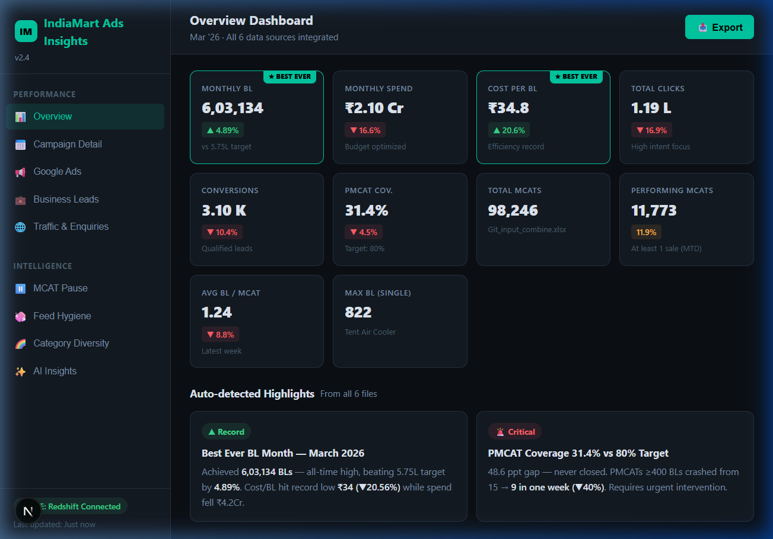
Task 6: Campaign Details — Standard View Dashboard
Performance Header: Displays the selected MCAT name, reporting date, and the database feed status (Redshift DWH).
Attribution Metric Cards: Renders key indicators including impressions, clicks, CTR, cost, conversions, BL approved, BL sold, cost per txn, and diversity.
Ranking Analysis: Shows top/bottom 10 performers sorted by any metric dynamically (e.g. conversions or cost/txn) for optimization.
Historical Trend: Plots cost, clicks, and impressions over a 12-week, 30-day, or 12-month trend line.

Slide 16

Task 6: Campaign Details — Compare Mode & AI Insights
Best Ever KPIs Banner: Highlights historic peak performance indicators across the compared periods for comparison benchmarks.
AI-Generated Insights: Dynamically generates textual alerts on budget overspends, cost-per-transaction anomalies, and bidding advice.
Metric Comparison Table: Provides grid breakdown of each metric across compared weeks/days/months to track percentage improvements.
Cascading Selectors: Interactive filters allow side-by-side comparison of specific groups, PMCATs, or individual MCAT campaigns.

Slide 17
Task 6: Campaign Details — Business Value & Manager Benefits
Resolving Core Painpoints
Manual Data Removal: Replaces slow copy-paste Google Sheets pipelines and manual weekly SQL queries.
Direct Redshift Feed: Eliminates DBeaver credentials bottleneck for stakeholders by embedding query execution inside UI.
Dynamic Aggregations: Solves interval limits, displaying clean Daily, Weekly, and Monthly charts on the fly.
Streamlined Views
Standard Attributions: Shows live impressions, CTR, cost, conversions, and transaction costs at group/PMCAT/MCAT level.
Compare Mode: Enables side-by-side performance grids across adjacent periods with change indicators.
Best Ever KPIs: Exhibits peak historical benchmarks as targets for current active advertising campaigns.
Manager Benefits
Faster Decision Making: Allows product and ads managers to react within seconds to spending spikes or CTR drops.
Root Cause Drilldown: Enables descending drilldowns through selectors to isolate underperforming MCAT categories.
AI Actionable Insights: Translates complex performance data into simple bid advices and budget warning summaries.

Slide 18
Key Learnings
01
Data → Actionable Insights
Learned to translate messy, real-world ad data into structured metrics that drive product decisions
02
Automation for Scale
Manual reporting is unsustainable at scale; automation via n8n + Apps Script enables consistent, timely insights
03
SQL & Ads Ecosystem
Gained some understanding of Google Ads(Types of Ads, KPIs, rules) and SQL querying across complex data
04
Product Thinking
Connecting individual KPIs (Cost/Txn, BL Approved) to build interactive dashboard
05
Handling Imperfect Data
Real datasets have gaps, mismatches, and missing fields — robust conditional logic and validation is essential
IndiaMART | Product Management Internship | April 2026
Notes:
Mutual gains of busy user- and IM..

Slide 19
Next Steps
01
Fix Daily KPI Tracker Automation
Make the daily tracker for all other campaigns as well
02
Resolve DB Inconsistencies
Investigate and reconcile the 13K DB vs 19K MCAT Mesh data mismatch across sources
03
Build Live KPI Dashboard
[Completed] Interactive dashboard built on Next.js, connected to live Redshift DB with Daily/Weekly/Monthly filters.
04
Automate Custom Label Mismatch
Live MCAT-wise Custom Label 3 feed needs to be automated — replacing the weekly manual download with a direct API or DB pull to enable continuous mismatch monitoring.
05
Recommendation Engine
Add automated bid/budget recommendations directly within daily email reports
IndiaMART | Product Management Internship | April 2026
Notes:
Mutual gains of busy user- and IM..

Slide 20
Thank You

